Slide 1
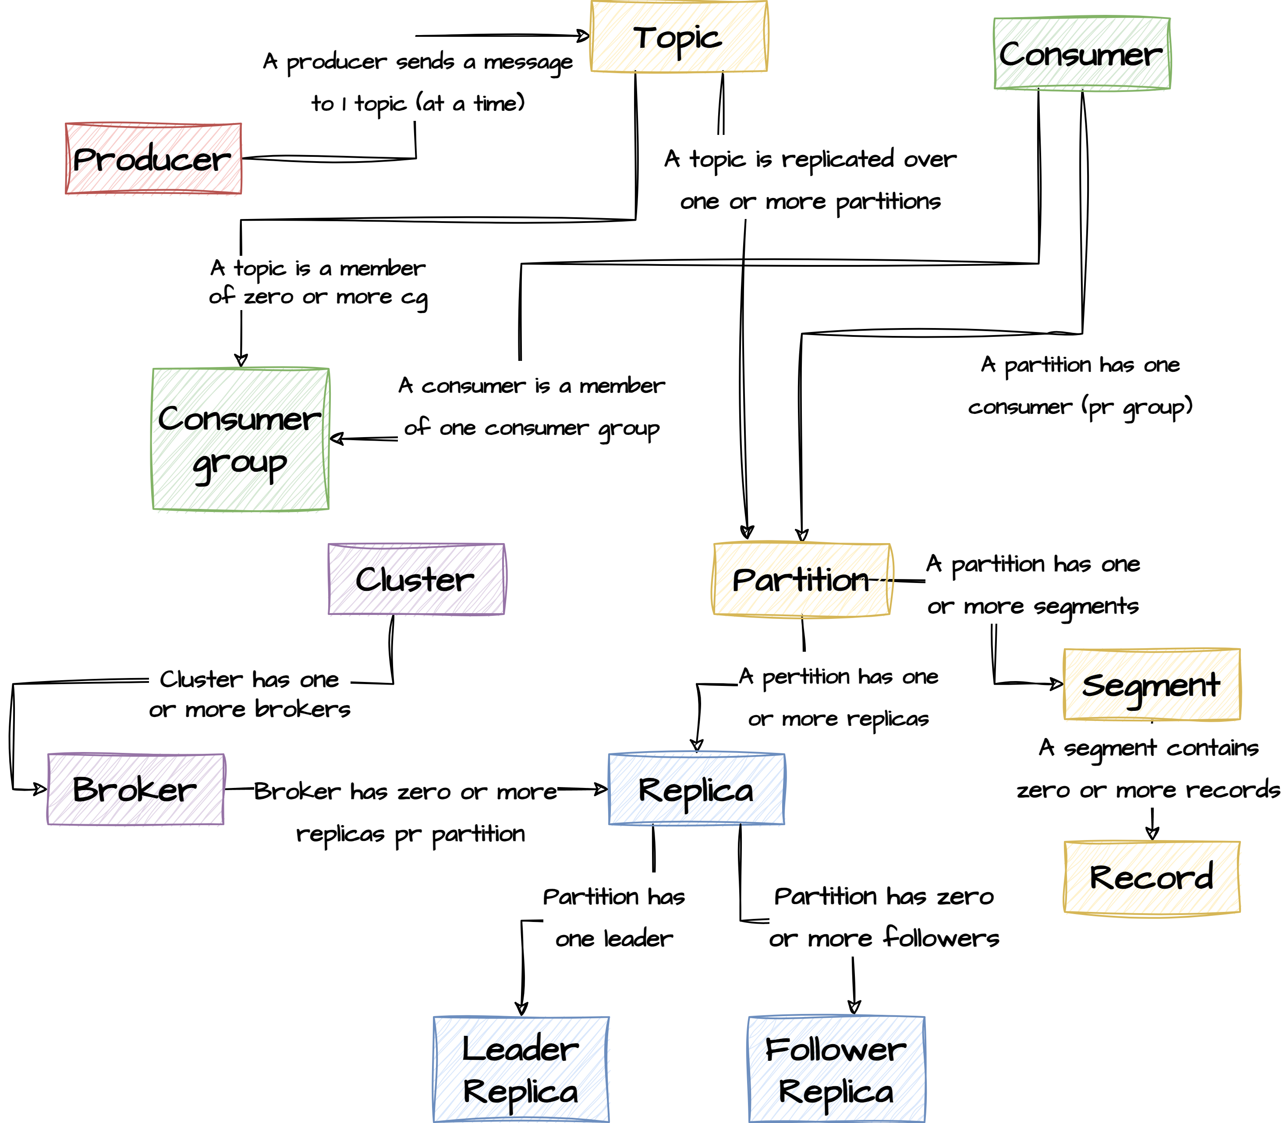
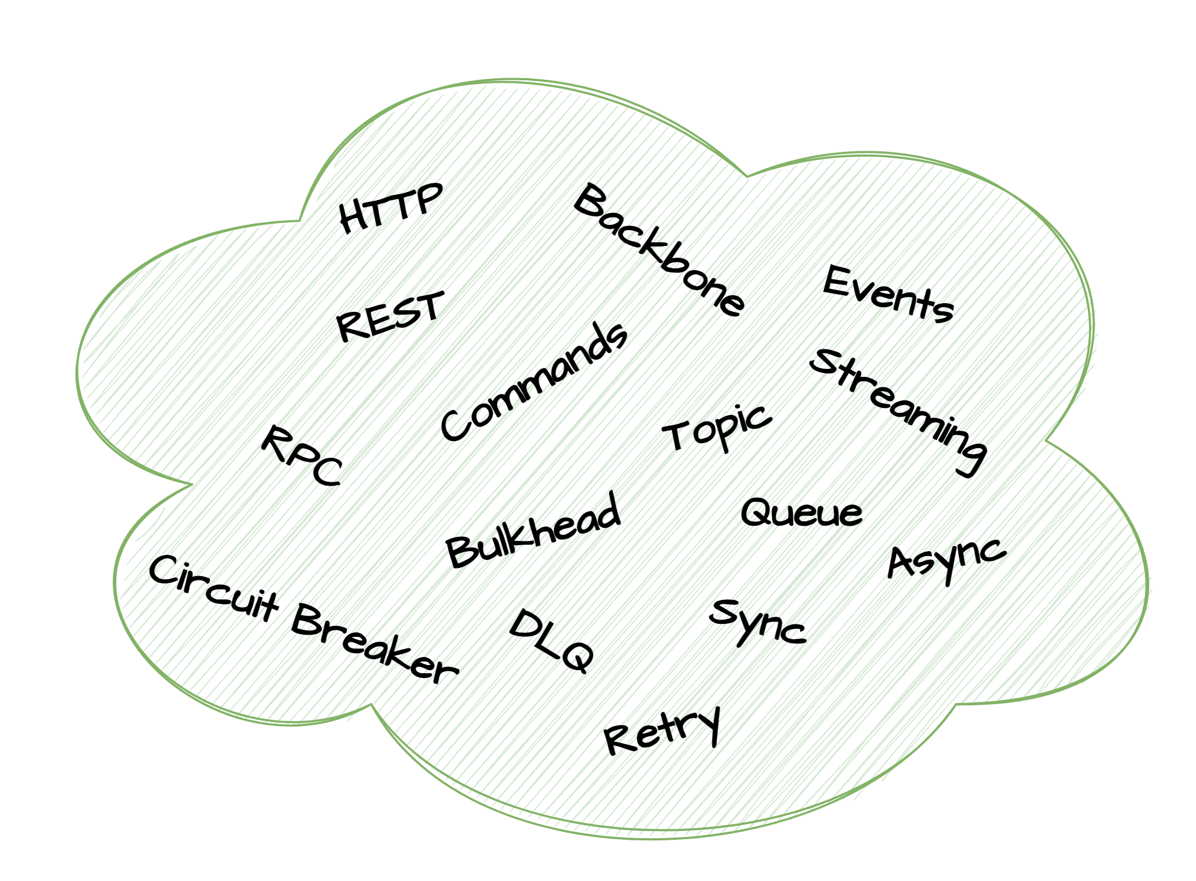
Day one
Introduction
Kafka overview
Kafka broker
Kafka producer
Kafka consumer
Day two
Kafka Spring
Kafka Streams
Kafka Connect

Slide 2
